Slide 1
System Analysis and Design on
Railway reservation system

Slide 2
Submitted to Dr. Saleh Ahmed
Submitted by
Name | ID
Rayhan Islam | 18ICTCSE040
Israt Jahan Reshma | 18ICTCSE041
Akram | 18ICTCSE043
Masud Rana | 18ICTCSE044
Rakibul Islam Himel | 18ICTCSE045
Nahidul Islam Shakin | 18ICTCSE046

Slide 3
INTRODUCTION
In Railway reservation system there has been a collection of trains, agent who are booking tickets for customer’s journey which give train ticket number and departure time of the train.
According to its name it manages the details of all agent, tickets, rental details, and timing details and so on.
The main objective of this project is to provide the better work efficiency, security, accuracy, reliability, feasibility.

Slide 4
SCOPE & OBJECTIVE
All the manual work should be converted into computerized so that the load of employees should decrease.
The database should be stored in computer rather than in register / manually.
The railway reservation system software is an easy to use self service system which enables the customer buys train ticket online.
After process buys train ticket is successfully, the customer can get the train ticket by print out the train ticket or can download the pdf of train ticket.

Slide 5
FEATURES
Searching of data is easy.
Passengers don’t have to wait for long time.
Information is accurate.
It is fast process.
Data efficiency is more.

Slide 6
Bangladesh Railway E-Ticketing Problems
Session time out due to enquiry limit.
Limited server cause slow speed.
Multiple failures during form filling, saving of form should be dynamic.
Cancelled transaction problem during tatkal hours, many times during tatkal hours ticket is not booked even after payment due to slow speed of Bangladesh Railway E-Ticketing Service or due to limited server.
Limit of ip address of particular computer for only two ticket for whole time during tatkal hours.
Slow processing speed during tatkal hours due to heavy traffic.

Slide 7
IMPROVEMENT REQUIRED IN BANGLADESH RAILWAYS
BRES (Bangladesh Railway E-Ticketing Service) should introduce wallet scheme so that transaction become easy or time consumption of redirecting to merchant sites will be saved.
BRES installation of more servers for good speed even during heavy rush time.
Proper inspection of ticket and I.d of passengers so that improper booking that is being done by agents on anonymous identity can be reduced.
Improvement in like saving of filled form dynamically so that in case of disconnection of internet user didn’t need to refill the form again from start, it should start form where it was left, it will be saved in cache memory of web browser which can be used further.

Slide 8
Refund process should be fast.
International debit and credit card should be accepted by BRES.

Slide 9
Requirements:
1) Hardware Requirements:
Processor : Pentium IV 2GHz and Above
RAM : 1GB
Monitor : VGA Color Monitor
2) Software Requirements:
Operating System : Windows XP onwards
Developing Tool : html,css(front end)
Database : php ,javascript (back end)

Slide 10
Data flow diagram:
The data flow diagram is a graphical representation that depicts information flow and the transforms that are applied as data moves from input to output.
Context level or 0-level DFD
1-level DFD
2-Level DFD

Slide 11
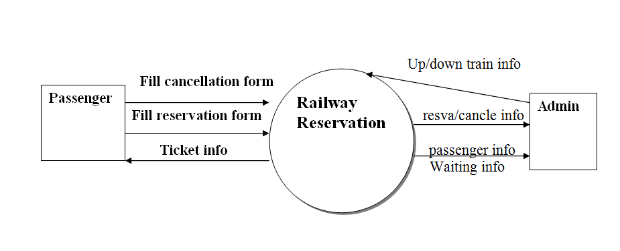
Context level or 0-level DFD:

Slide 12
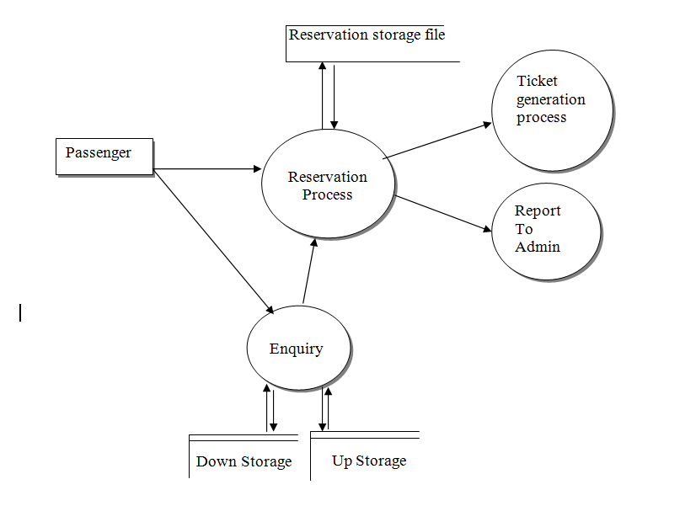
1-level DFD:

Slide 13
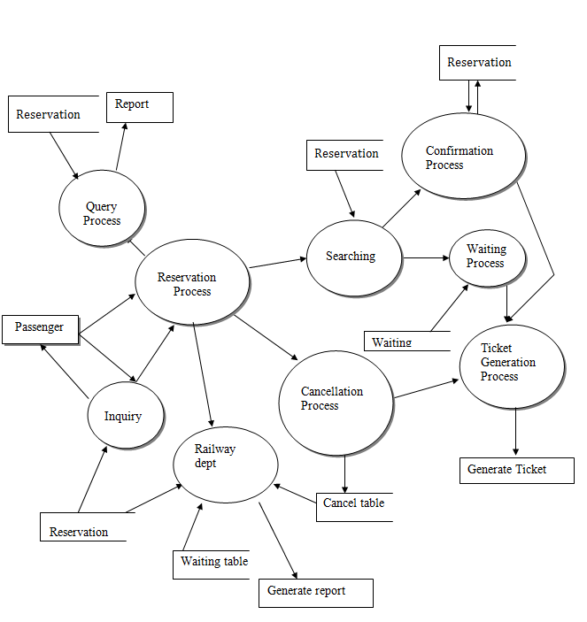
2-level DFD:

Slide 14
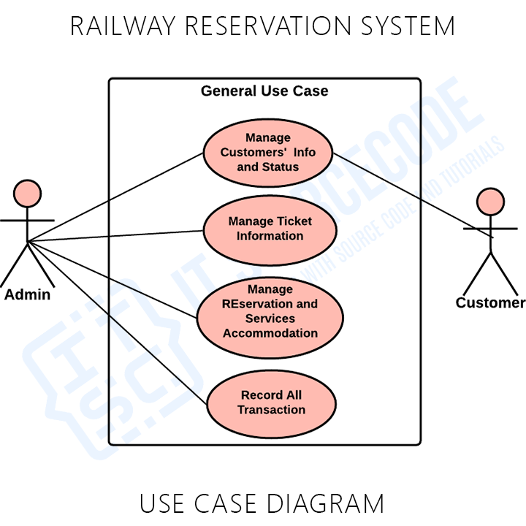
Use Case Diagram:

Slide 15
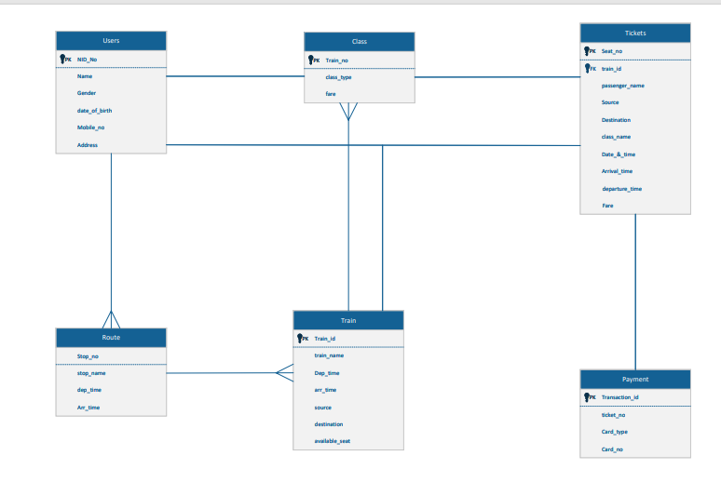
ER Diagram

Slide 16
Thank you

